Slide 1

Message Queue Telemetry Transport mqtt

Slide 2

content
MQTT publish-subscribe,
MQTT architecture details,
MQTT packet structure,
MQTT communication formats,
MQTT working example

Slide 3
Introduction
MQTT protocol - Message Queuing Telemetry Transport - protocol for transmitting a sequence of messages with telemetric data, i.e. information from sensors of temperature, humidity, light, etc. MQTT was proposed in 1999 by Andy Stanford-Clark as a protocol that would serve to transmit real-time data on the state of the pipeline and gas pipeline. The development was conducted by IBM for the new pipeline of the largest American oil company ConocoPhillips. As part of the creation of a dispatching control and data acquisition system (SCADA), it was necessary to ensure a guaranteed collection of a wide variety of information: pump status, bearing temperature, flow rate, valve status, tank levels, etc. In this case, it was necessary to take into account the high cost of communication channels and a narrow bandwidth. None of the existing protocols suited these tasks, thus, the requirements for the new protocol were formed: quality of service, two-way communication, efficient use of bandwidth. The MQTT protocol was first published by the OASIS (Organization for the Advancement of Structured Information Standards) consortium in October 2014. In June 2016, the standard was recognized by the International Organization for Standardization (ISO). MQTT Version 3.1.1 was registered by the ISO Technical Committee on Information Technology (JTC1) under ISO / IEC 20922. Key Features of the MQTT Protocol: - messaging is done on a Pub-Sub basis; - the size of the message header is 2 bytes, and the payload can vary from 1 byte to 260 MB; - the protocol includes the ability to choose one of three levels of service.

Slide 4
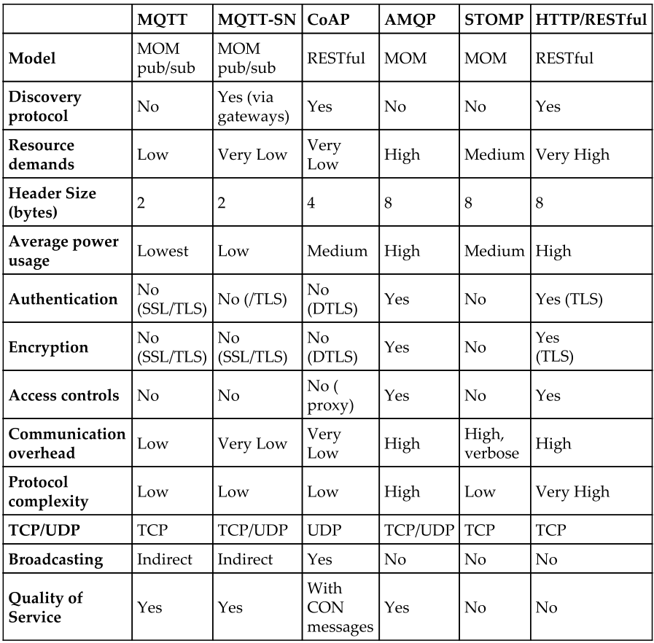
Protocol summary and comparison

Slide 5
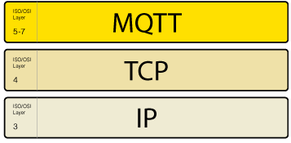
Network Connections
The MQTT protocol requires an underlying transport that provides an ordered, lossless, stream of bytes from the Client to Server and Server to Client.
Non normative comment
The transport protocol used to carry MQTT 3.1 was TCP/IP as defined in [RFC793]. TCP/IP can be used for MQTT 3.1.1. The following are also suitable:
· TLS [RFC5246]
· WebSocket [RFC6455]
Non normative comment
TCP ports 8883 and 1883 are registered with IANA for MQTT TLS and non TLS communication respectively.
Connectionless network transports such as User Datagram Protocol (UDP) are not suitable on their own because they might lose or reorder data.
http://docs.oasis-open.org/mqtt/mqtt/v3.1.1/os/mqtt-v3.1.1-os.html#_Toc398718098

Slide 6
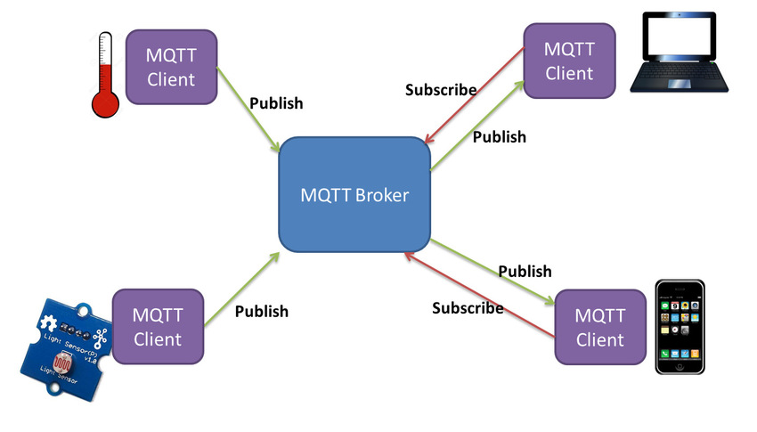
MQTT publish/subscribe Diagram

Slide 7
Publisher-Subscriber Principle
A distinctive feature of the publisher-subscriber principle from the client-server approach is that the clients sending messages (publishers, Publisher) and the clients receiving messages (subscribers, Subscriber) are usually separated. Separation can be organized in three planes:
- space - the publisher and the subscriber are not required to know each other;
- time - the publisher and subscriber should not be included at the same time;
- synchronization - operations on both sides should not be suspended during the publication or receipt of information.
The publisher and the subscriber do not transmit messages directly to each other, do not establish direct contact, may not know about each other's existence. Coordinates and manages the transfer of messages from the publisher to the subscriber and from the subscriber to the publisher broker. Parallelizing operations on a broker is the second important feature of the publisher-subscriber interaction principle.
An MQTT client is a device equipped with a microcontroller that supports the TCP / IP stack. MQTT client libraries are available for a large number of programming languages, for example, Android, Arduino, C, C ++, C#, Go, Java, JavaScript.
The broker is the main element of the publisher-subscriber system. He is responsible for receiving all messages, filtering them, deciding who is interested in these messages, and, ultimately, for sending messages to all subscribing clients.
Among the server implementations of the broker, we can distinguish IBM WebSphere MQ; open source Mosquitto; a solution based on the Eurotech Everywhere Device Cloud; easily scalable and high-performance open server emqttd, the latest version allows you to serve 1.3 million connections; HiveMQ broker, providing corporate security and maximum scalability.
A simplified information exchange process can be described as follows:
The publisher sends a message with data (for example, information from temperature sensors) to the broker, while indicating the topic (Topic) to which this data refers (for example, "Temp").
The broker analyzes which of the subscribers have a subscription to certain topics, in this case, the theme "Temp".
Subscribers who subscribe to the topic "Temp", a broker will send a message with information from temperature sensors.

Slide 8
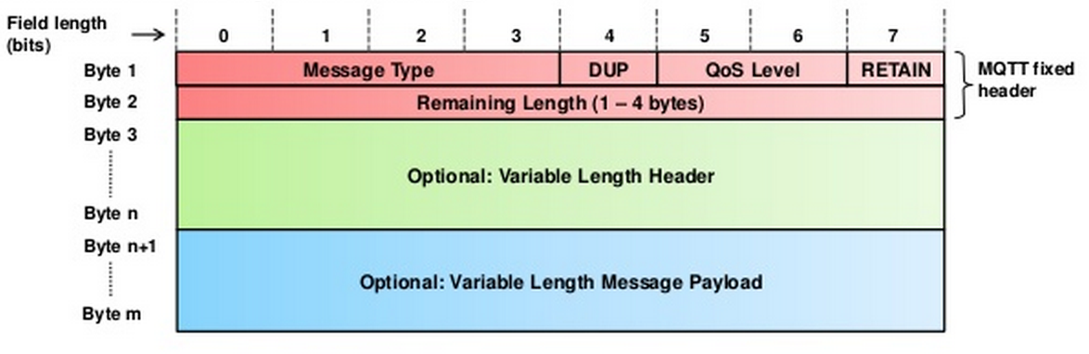
MQTT protocol message format
DUP = Duplicate delivery of a PUBLISH Control Packet
QoS = PUBLISH Quality of Service
RETAIN = PUBLISH Retain flag
The Remaining Length is the number of bytes remaining within the current packet, including data in the variable header and the payload.

Slide 9
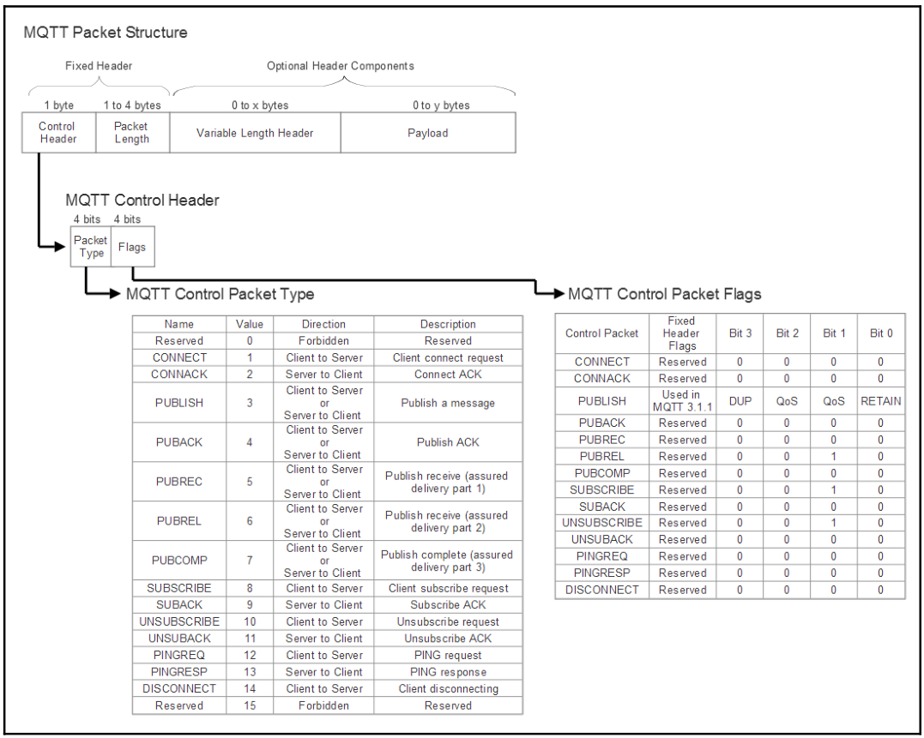

Slide 10
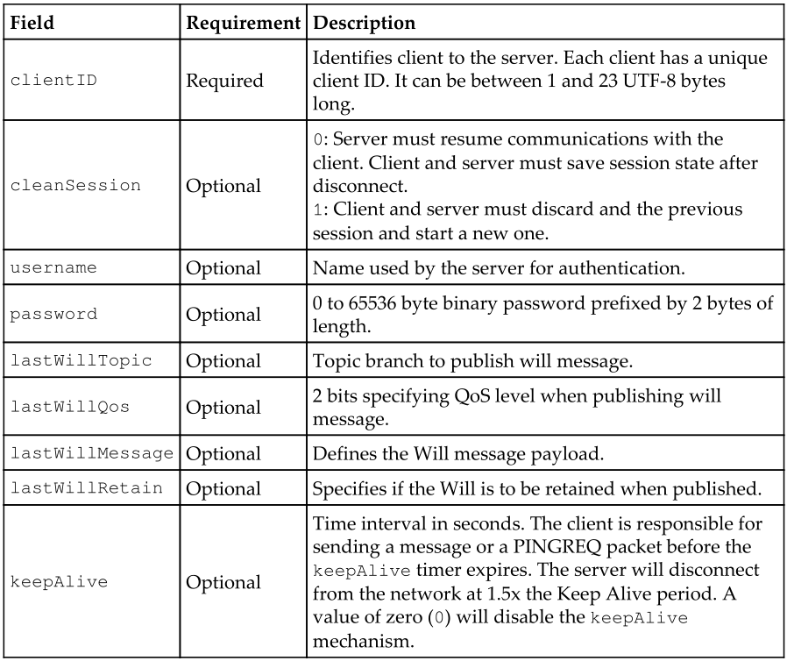
CONNECT format (client to server)
A typical CONNECT message will contain the following (only the clientID is required to initiate a session)

Slide 11
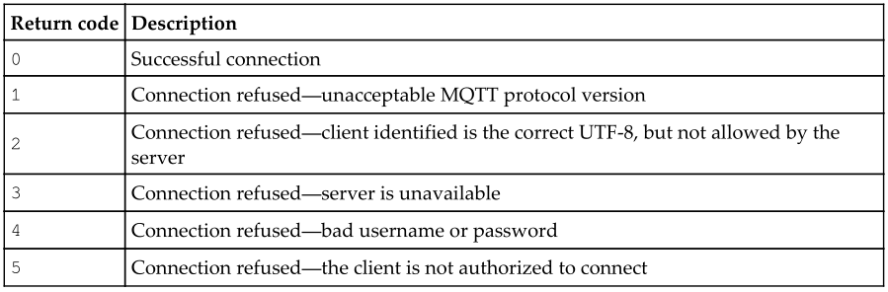
CONNECT return codes (server to client)
The broker will respond to a
CONNECT message with a response code. A designer should be aware that not
all connections may be approved by a broker. Response codes are as follows

Slide 12
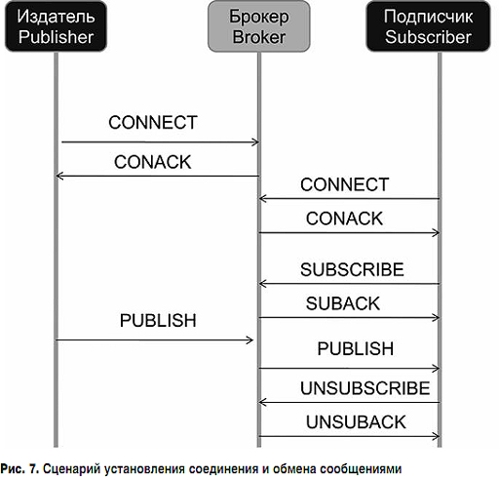
Connection diagram

Slide 13
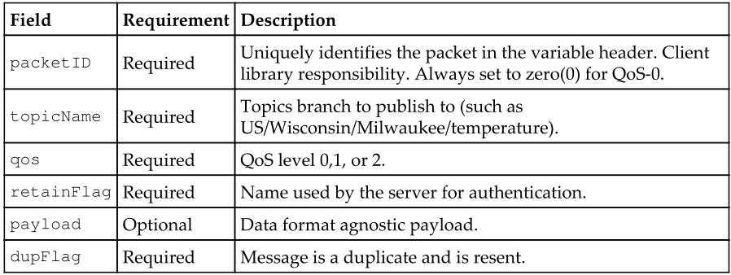
PUBLISH format (client to server)
At this point, a client may publish data to a topic branch. Each message contains a topic

Slide 14
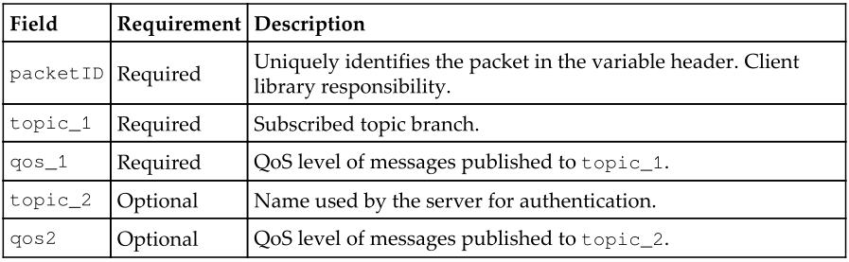
SUBSCRIBE format (client to server)
The payload of a subscribe packet includes
at least one pair of UTF-8 encoded topicIDs and QoS levels. There may be
multiple topicIDs subscribed to in this payload to spare the client from multiple
broadcasts

Slide 15
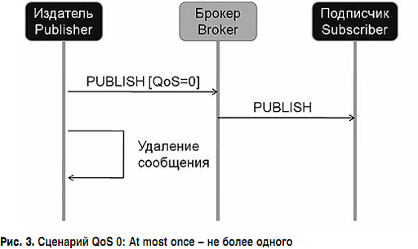
QoS 0: At most once
This is the minimal QoS level. This is
analogous to a fire-and-forget model detailed in some of the wireless protocols. It
is a best-effort delivery process without the receiver acknowledging a message or
the sender reattempting transmission.

Slide 16
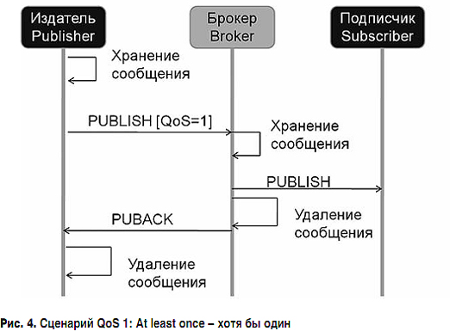
QoS 1: At least once
This mode will guarantee delivery of the message
at least once to the receiver. It may be delivered more than once, and the receiver
will send an acknowledgment back with a PUBACK response.

Slide 17
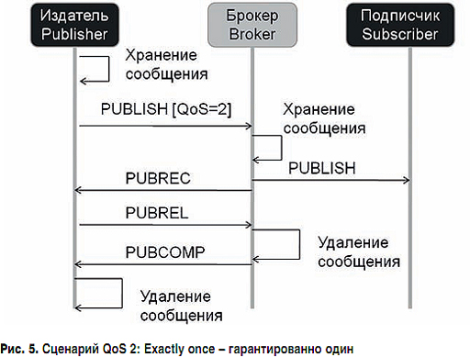
QoS 2: Exactly one
This is the highest level of QoS that
ensures and informs both the sender and receiver that a message has been
transmitted correctly. This mode generates more traffic with a multi-step
handshake between the sender and receiver. If a receiver gets a message set to
QoS-2, it will respond with a PUBREC message to the sender. This acknowledges
the message and the sender will respond with a PUBREL message. PUBREL
allows the receiver to safely discard any re-transmissions of the message. The
PUBREL is then acknowledged by the receiver with a PUBCOMP. Until the
PUBCOMP message is sent, the receiver will cache the original message for
safety.

Slide 18
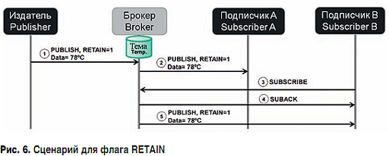
RETAIN flag
Special RETAIN flag. This flag is used to indicate the saving of the last message received by the broker. That is, the RETAIN = 1 flag in the PUBLISH message from the publisher tells the broker that the message on this topic needs to be saved and, when a new subscriber joins the topic, send him this message.

Slide 19
Understanding wildcards
Plus sign (+) Single level wildcard : It is a single level wildcard that matches any name for a specific topic level. We can use this wildcard instead of specifying a name for any topic level in the topic filter.
Hash (#) Multi-level wildcard : It is a multi level wildcard that we can use only at the end of the topic filter, as the last level and matches any topic whose first levels are the same as the topic levels specified at the left-hand side of the # symbol.
sensors/drone01/altitude
sensors/drone02/altitude
sensors/superdrone01/altitude
sensors/thegreatestdrone/altitude
If we publish messages to the following topics, the subscriber that used the sensors/+/altitude topic filter will receive all of them
sensors/drone01/speed/rotor/1
sensors/superdrone01/speed/rotor/2
sensors/superdrone01/remainingbattery
In case we want to receive all the messages related to all the sensors for the drone named drone01, we can use the # multi level wildcard after the drone name and the slash (/). We can use the following topic filter: sensors/drone01/#.
$ Special topics: This is a special statistical mode for MQTT brokers. Clients
cannot publish to $ topics. There is no official standard for use at the moment.
One model uses $SYS in the following manner: $SYS/broker/clients/connected.

Slide 20
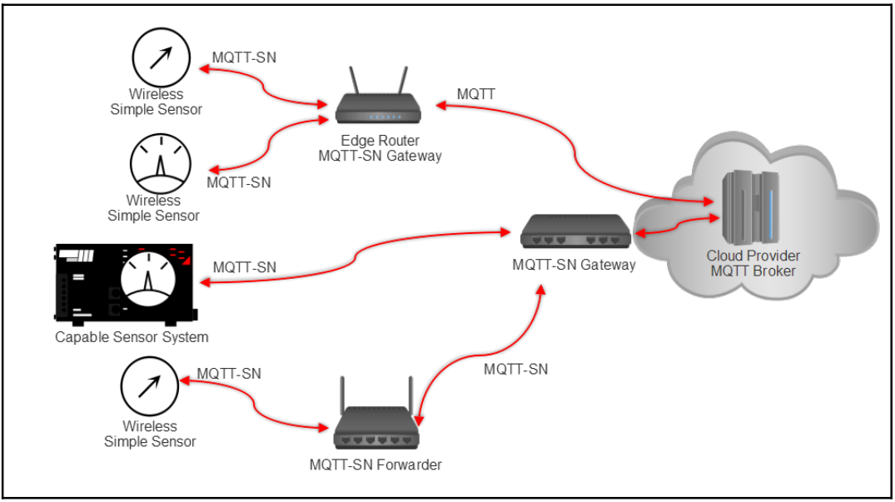
MQTT-SN
A derivative of MQTT is called MQTT-SN (sometimes called MQTT-S) for sensor networks.
It keeps to the same philosophy of MQTT as a lightweight protocol for edge devices but is
architected specifically for the nuances of a wireless personal area network typical in sensor
environments. These traits include support for low-bandwidth links, link failure, short
message length, and resource-constrained hardware. MQTT-SN is, in fact, so light that it
can be run successfully over BLE and Zigbee.
MQTT-SN does not require TCP/IP stack. It can be used over a serial link (preferred way),
where a simple link protocol (to distinguish different devices on the line) overhead is really
small. Alternatively it can be used over UDP, which is less hungry than TCP.
Gateways: In MQTT-SN, a gateway has the responsibility of protocol conversion
from MQTT-SN to MQTT and vice versa (although other translations are
possible). Gateways can also be aggregating or transparent (covered later in this
chapter).
Forwarders: A route between a sensor and an MQTT-SN gateway may take many
paths and hop across several routers along the way. Nodes between the source
client and the MQTT-SN gateway are called forwarders and simply re-
encapsulate MQTT-SN frames into new and unchanged MQTT-SN frames that
are sent to the destination until they arrive at the correct MQTT-SN gateway for
protocol conversion.
Clients: Clients behave in the same way as in MQTT and are capable of
subscribing and publishing data.

Slide 21
Differences between 3.1.1 and 5.0
https://github.com/mqtt/mqtt.github.io/wiki/Differences-between-3.1.1-and-5.0

Slide 22
Mosquitto SSL Configuration -MQTT TLS Security
http://www.steves-internet-guide.com/mosquitto-tls/
http://www.steves-internet-guide.com/configuring-the-mqtt-publish-node/

Slide 23
References
Perry Lea “Internet of Things for Architects”
Building Real-time Mobile Solutions with MQTT and IBM MessageSight
http://docs.oasis-open.org/mqtt/mqtt/
http://lib.tssonline.ru/articles2/fix-corp/protokol-mqtt-osobennosti-varianty-primeneniya-osnovnye-protsedury-mqtt-protocol.
https://docs.espressif.com/projects/esp-idf/en/latest/api-reference/protocols/mqtt.html
http://www.steves-internet-guide.com/
https://mosquitto.org/
https://test.mosquitto.org/ssl/index.php
https://thingsboard.io/docs/reference/mqtt-api/
https://pypi.org/project/paho-mqtt/

